Slide 1
Course Project Proposal
Applications of Deep Learning
Winnie Har
Mark Trovinger
Yash Bhandare
Atharva Atre

Slide 2
Inspiration
Project Topic
How many languages are there in the world?
How many people in this room are multilingual?
Speech Translation Engine using Deep Learning

Slide 3
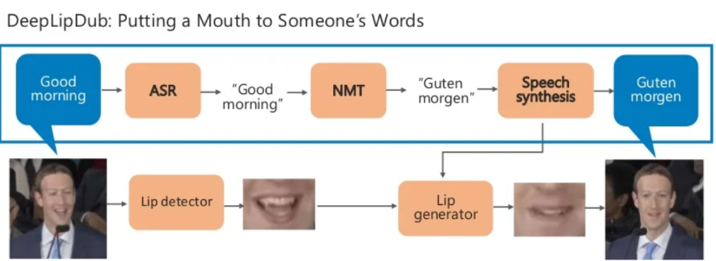
Speech Translation : Full Scale Project

Slide 4
Block diagram of Course Project
English speech to text
English text to language 2 text
Language 2 audio speech
Speech in English
Model 1
Model 2

Slide 5
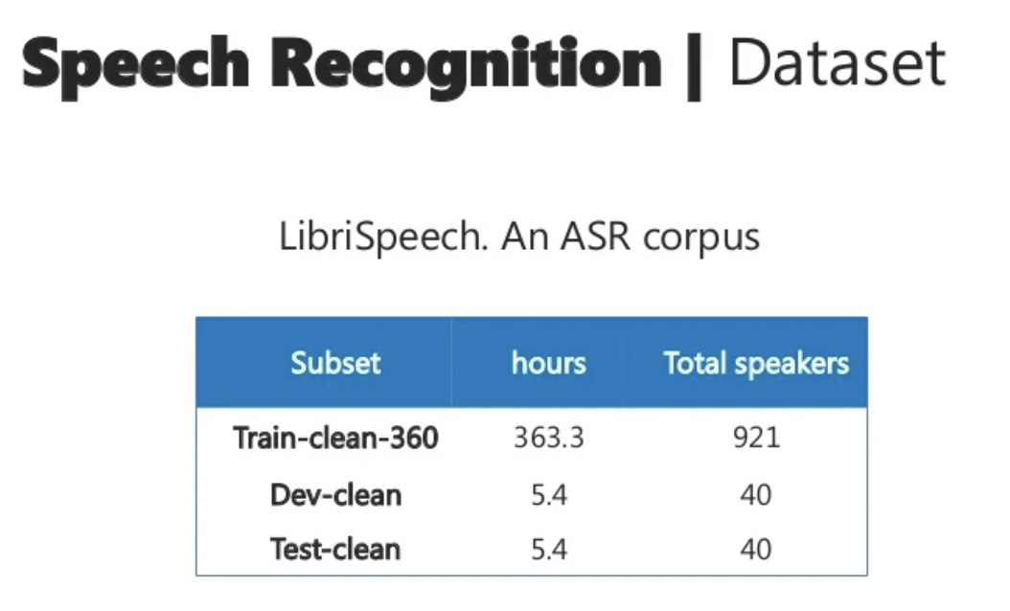

Slide 6
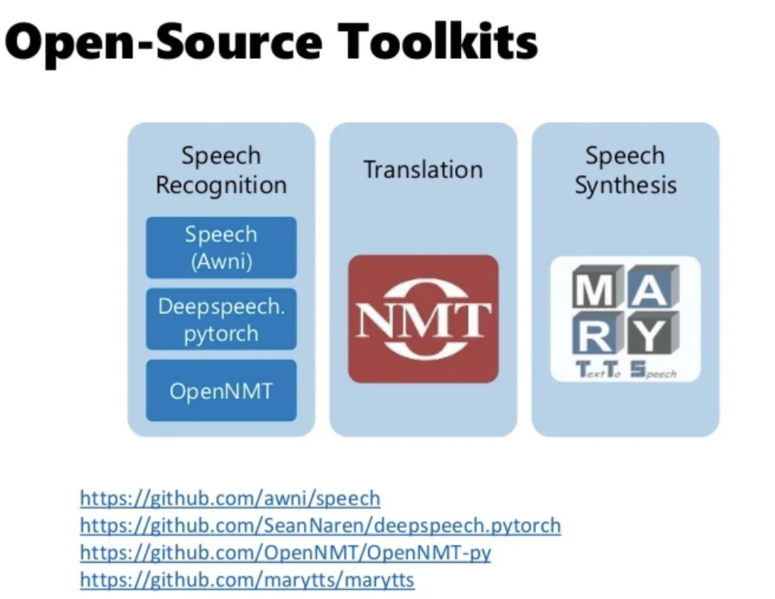

Slide 7
Challenges Faced
Machine translation is far from a solved problem, and depending on language, collection of data could range in difficulty.
There are different accents, different dialects within a language, making it difficult for the model to get accustomed to these differences.
Training resources - Model will require high computational power for training
Most of the end-to-end products currently in the market to solve this problem are proprietary property of the companies and are not made open source, making it difficult to get baseline open source reference model.

Slide 8
Thank You
Questions?

